Slide 1
Notes:
Die 1. Folie beinhaltet nur das Logo. Kein Text.

Slide 2
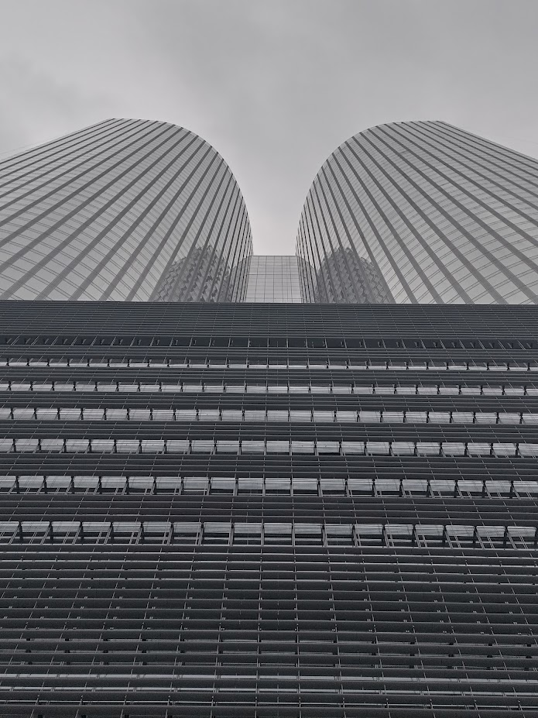
WS – BIM Global Meeting
Qiddiya Project Presentation
27.02.2026
Notes:
Oben, in grauer Schrift, steht der Name des/der Vortragenden. Darunter, in weißer Schrift, steht der Titel der Präsentation

Slide 3
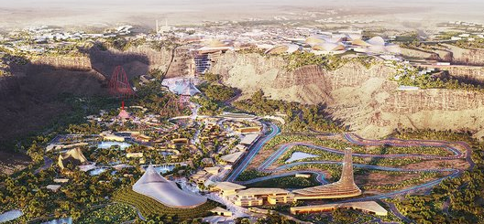
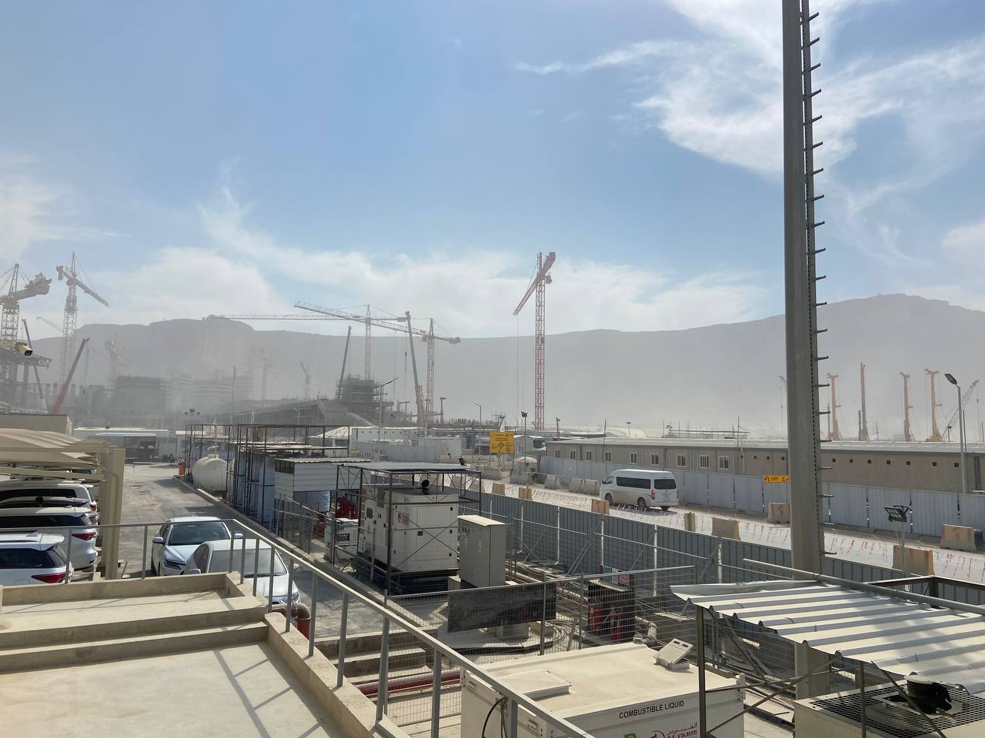

Qiddiya Project – Riyadh, Saudi Arabia​
City in the desert build from scratch that contains 6 different amusement parks.
WSBG creates LOD400 BIM model of Façade for two buildings for Speed Park cluster.​
Structural and thermal calculations for facade are prepared by WSIS.
City of entertainment in the desert with 6 parks in it​
First park to be built is Speed Park and 6 Flags

Slide 4
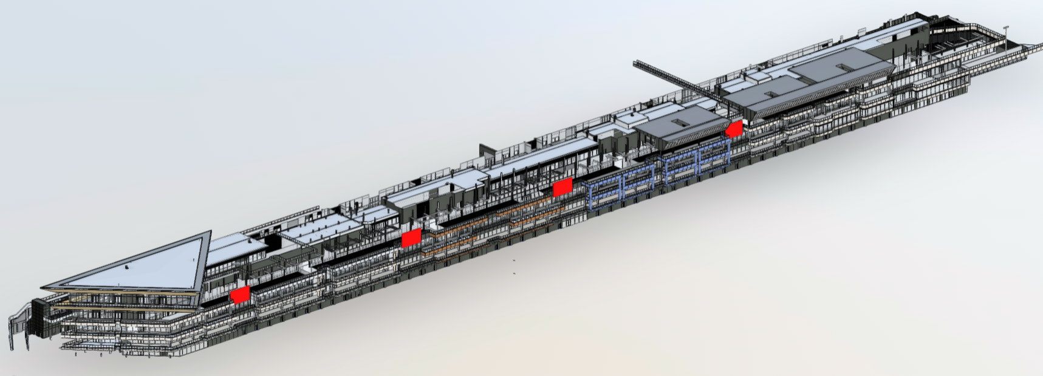
Facade Design Stages
Façade types that was previously developed in LOD300 (~LPH3) level must be developed as LOD400 BIM model
Façade types in
WS scope of work:
Glass Curtain Wall panels
Aluminum Cladded Panels
Glass Balustrade
Glass Canopy
Steel Subframes
Mechanical Louvers

Slide 5
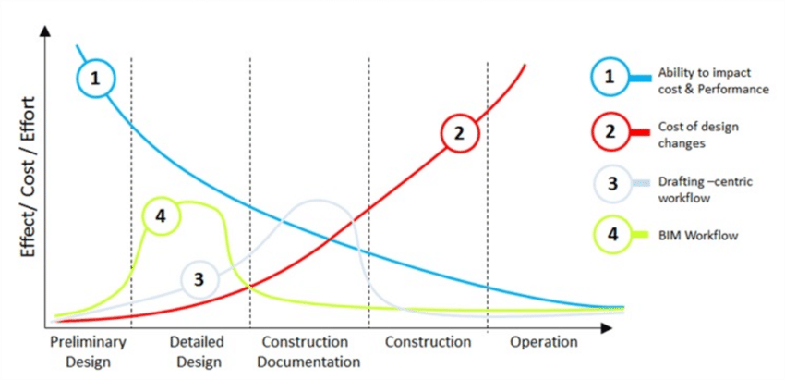
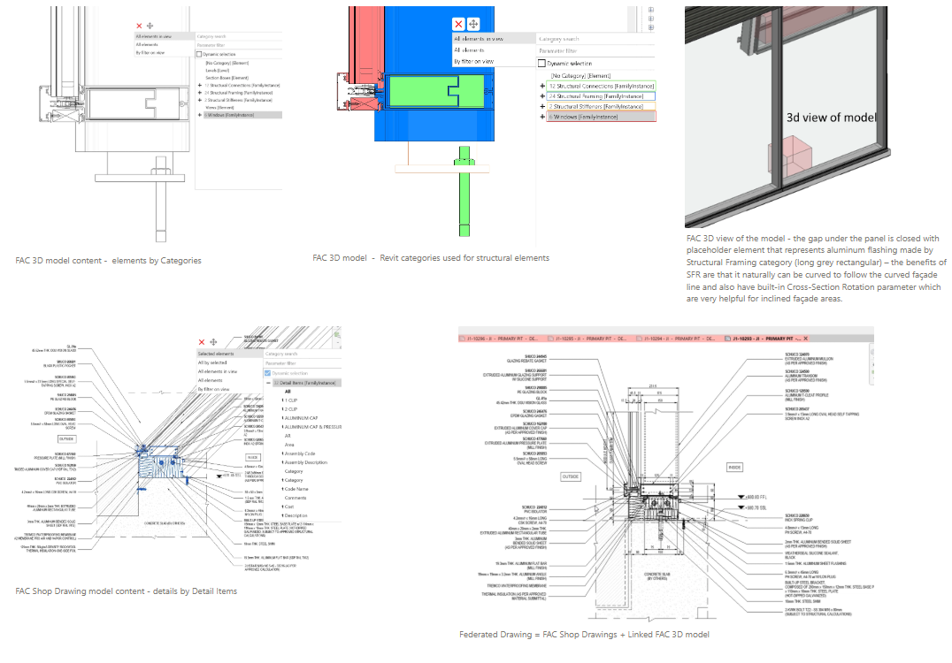
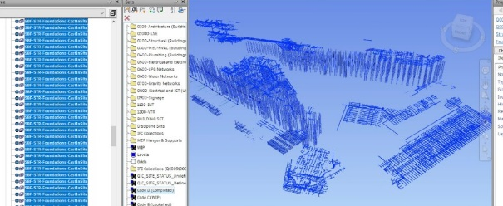
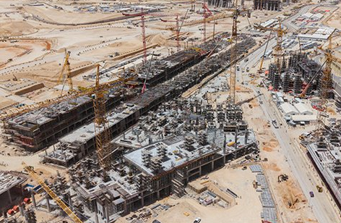
BIM use cases
3D coordination
Drawings extraction
MTOs and quantification of elements and materials
Speeding up and more control and coordination for the process of drawings development and applying changes
Cost of design changes are much more heavily on construction site than on design phase. Digital coordination spends time earlier but saves money later

Slide 6
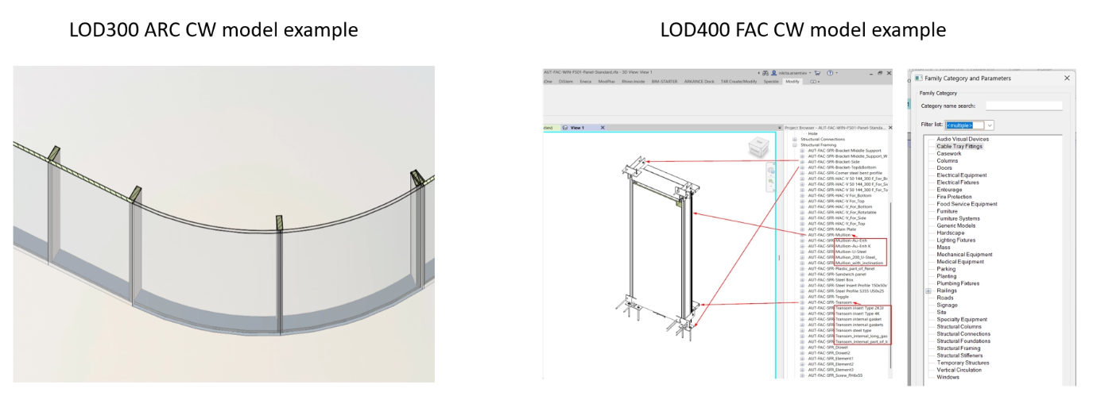
Revit BIM model development initial strategy
Scope of works contains BIM model and the possibility for the Shop Drawing team extract the drawings from the model with as well as the quantification of elements and materials.
Revit Built-in Category Curtain Wall can contain only built-in Categories Curtain Panels and Curtain Mullions.​
No possibility to change built-in Curtain Wall logic of rectangular subdivision and simple shapes of Mullions/Panels defined by Built-in Profile category.
Revit custom made Family can contain all required nested elements to match LOD400 and Shop Drawings extraction.​
Possibility to add different geometry and conditions to match design engineering requirements and MTOs of elements of Façade Systems.​

Slide 7
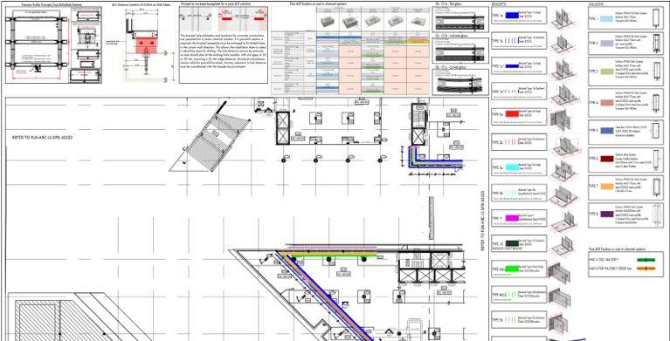
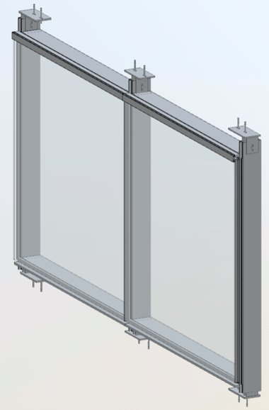
Structural Calculations and model development
WS structural team calculated the main elements of façade systems:
Mullions, Transoms, Glass, Brackets, Bolts, Connections
Structural calculations composed into report and technical assignment
Example of the Curtain Wall Glass panel family’s structural details

Slide 8
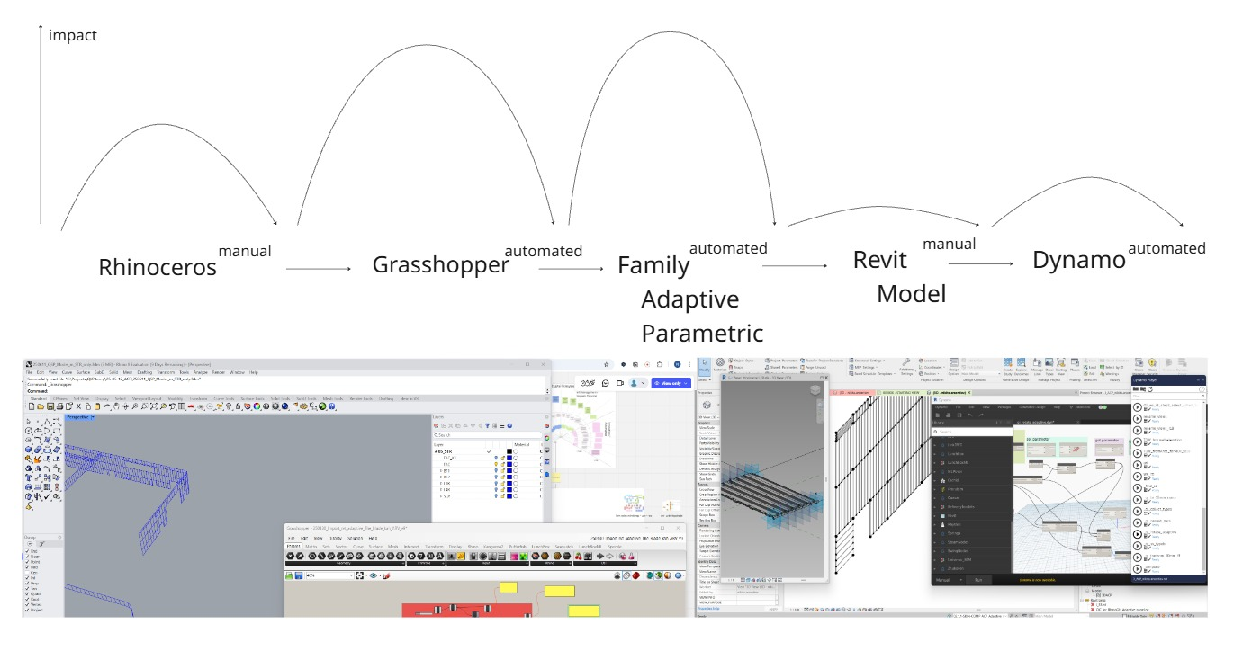
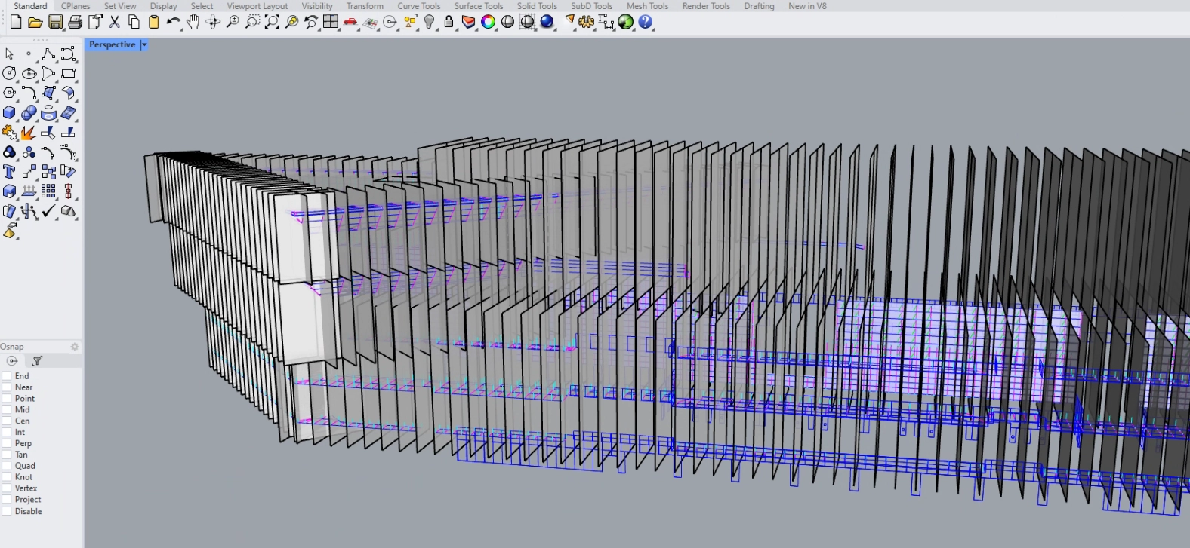
Rhinoceros open BIM approach for Aluminum Cladded Panels
Rhinoceros – Grasshopper – Revit workflow
Comparing operations consuming and impact on the progress “low- hanging fruits” are identified and developed in the first place

Slide 9
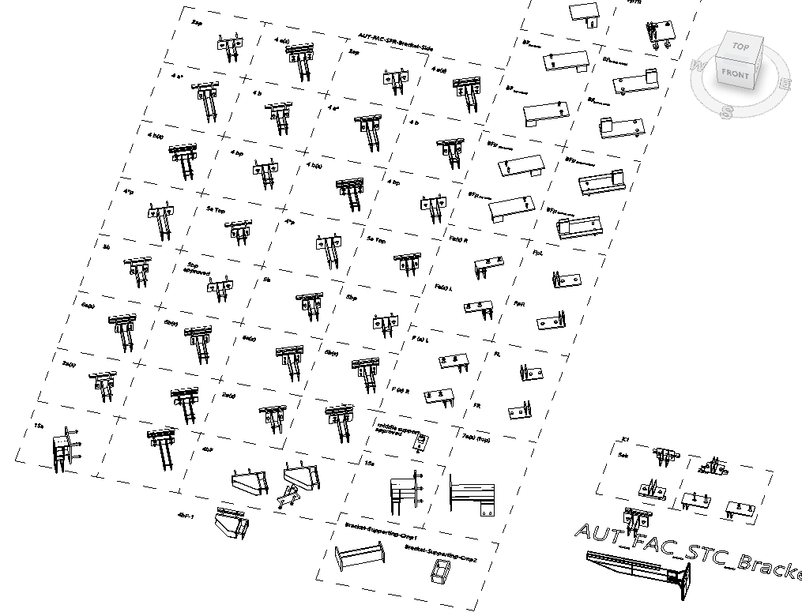
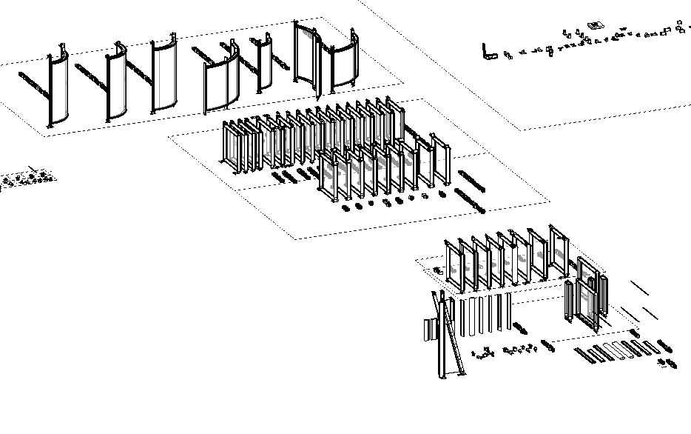
Set of developed families
Most challenging part is always 3D coordination after developing typical elements.
The set of brackets was increased from 20 typical to more than 100 unique elements.

Slide 10
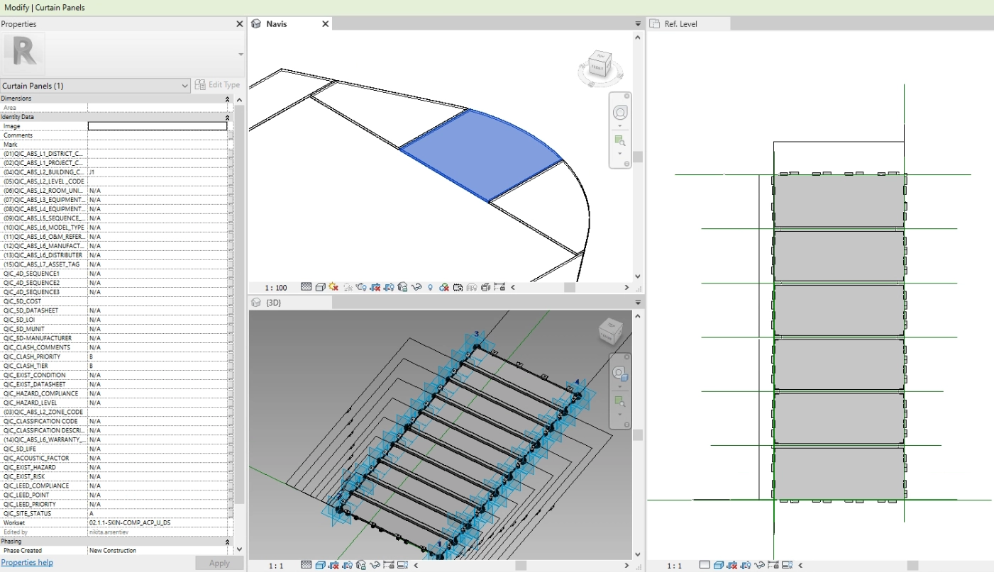
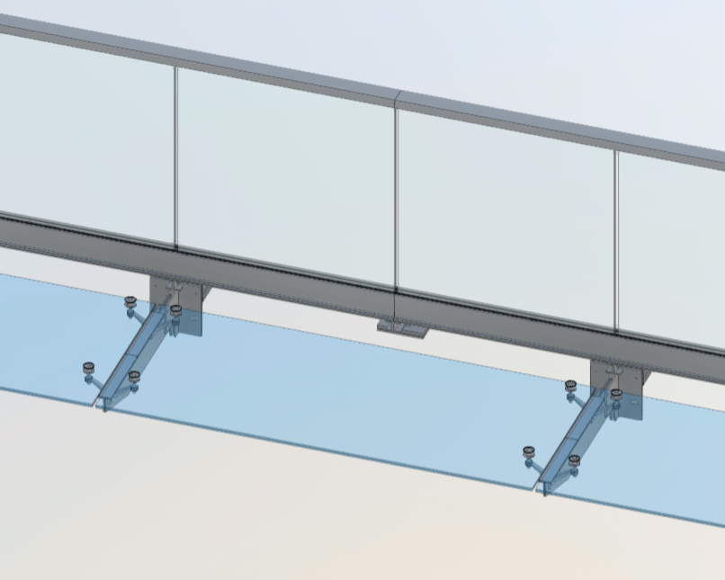
Variation of families step-by-step progress and details development
Revit naturally provides the revision-wise approach when it is possible to create simplified family element and then at the same time create instances of and add details to all of them
Revision 1 with only approved outer geometry is suitable for coordination but not for submission.
By the time when the Rev1 families will be placed in the model – family editor team will update family to Rev2 and all the placed elements will have updates as per project requirements.

Slide 11
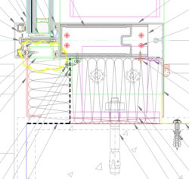
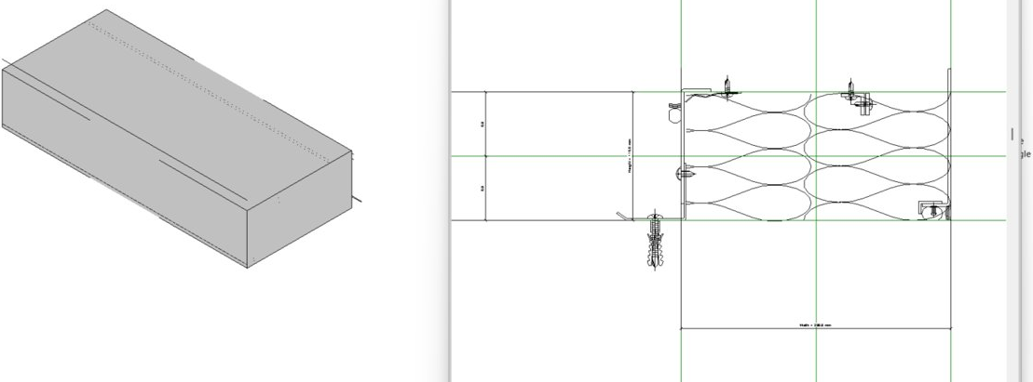
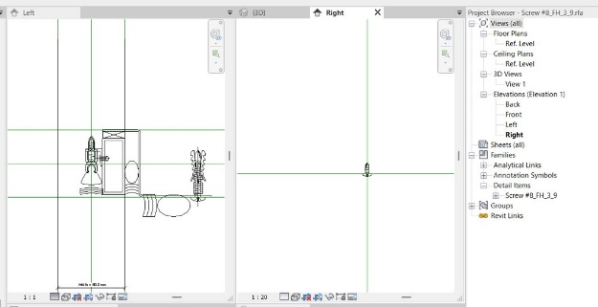
Shop Drawings extraction from models
Optimal solution to bring on all necessary details and don’t compromise the performance
Very sophisticated method of the mixing 3D and 2D elements using the “Shared” families with 2D details contents inside helped to read the actual dimensions of 3D elements and then using formulas in Revit families calculate the i.e. number of screws based on distance between screws – 300 or 400 mm for example and have a) full 2D details b) model-based element quantities c) reasonable size of model and performance due to limited number of small elements in Revit models

Slide 12
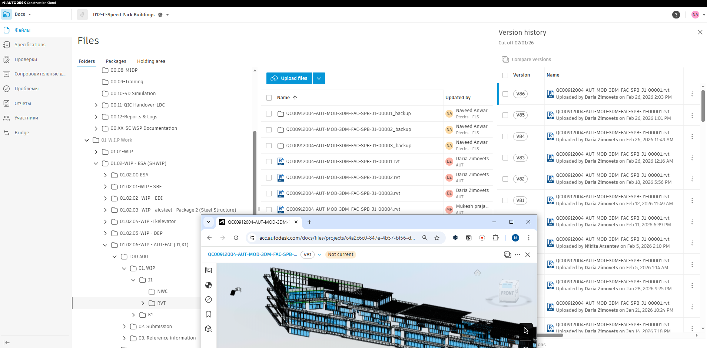
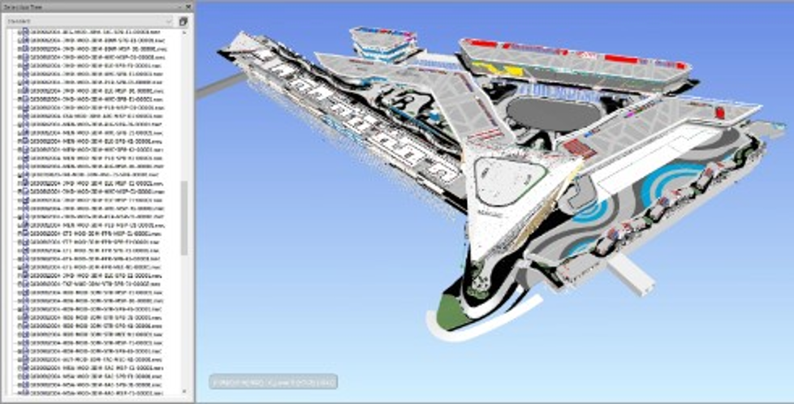
Digital cloud storages are heavily in use for all use-cases of models
WIP models are uploaded weekly to cloud storage
Updates from construction site are required to show Installed, WIP or Lookahead elements
Autodesk Construction Cloud is the main CDE platform for data exchange and Revizto as well to replace Navisworks or BIMCollab with the option of cloud work.
BIM360 is also in use for WS extended team because of option to give access to anybody without license and use benefits of 3D overview right in 3D browser.

Slide 13
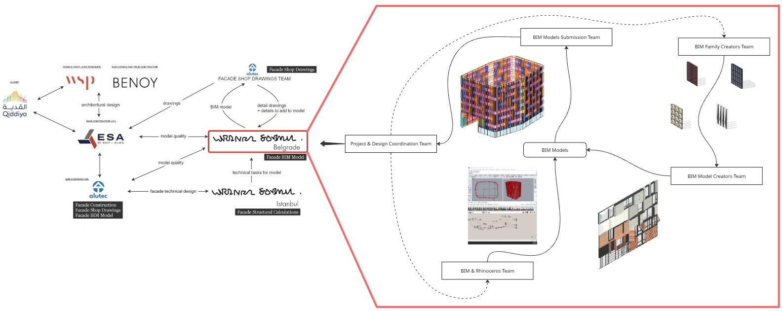
Digital skills are distributed across the team
Team work brings added value when synergy of skills gives 1+1 = 3 or even more.
Imaginary conveyor line is moving to bring technical assignment to family types then to family instance and then to complete models.

Slide 14
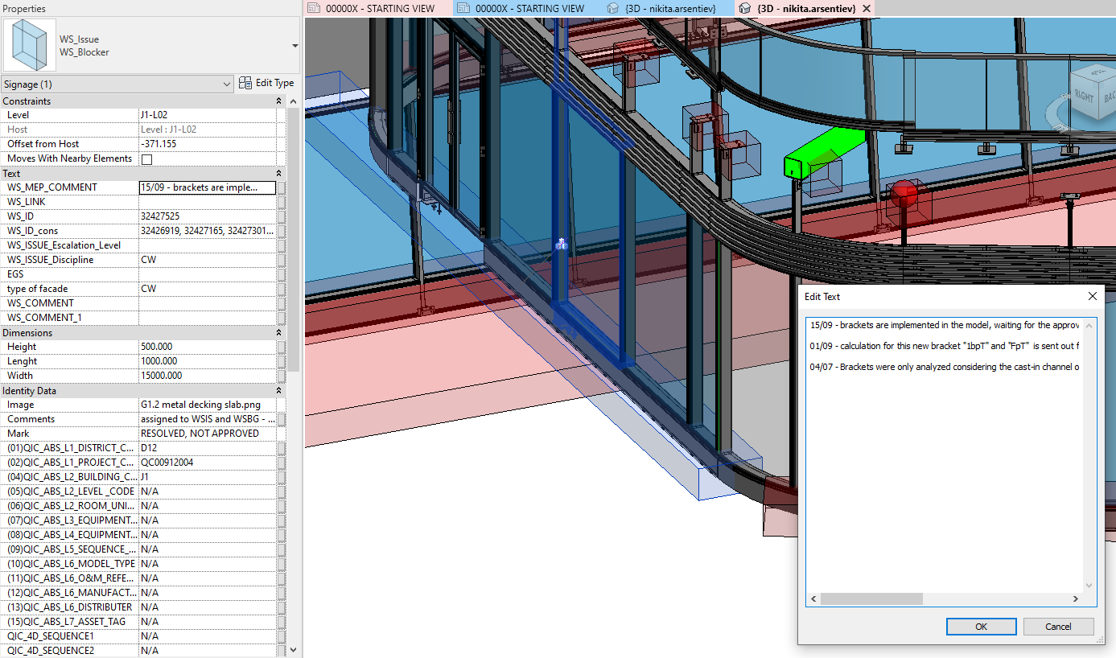
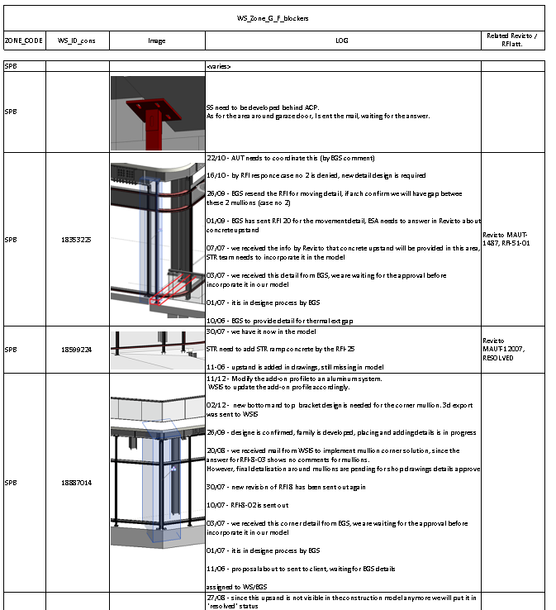
Blockers workflow - similar to ACC/BIM360 Issues but in Revit
When BIM Model development team meets the problematic place which cannot be developed without additional information it creates the “Blocker” – half transparent red box which covers the blocked area – to highlight that area is on hold and required info.
All the related information and comments are recorded in multi-text parameter with saved information date by date and appointed party. Element can be found in exported model in ACC with all text parameters values available. At the same time table view of the Blockers can be exported to Excel / PDF to be seen separately from the model.

Slide 15
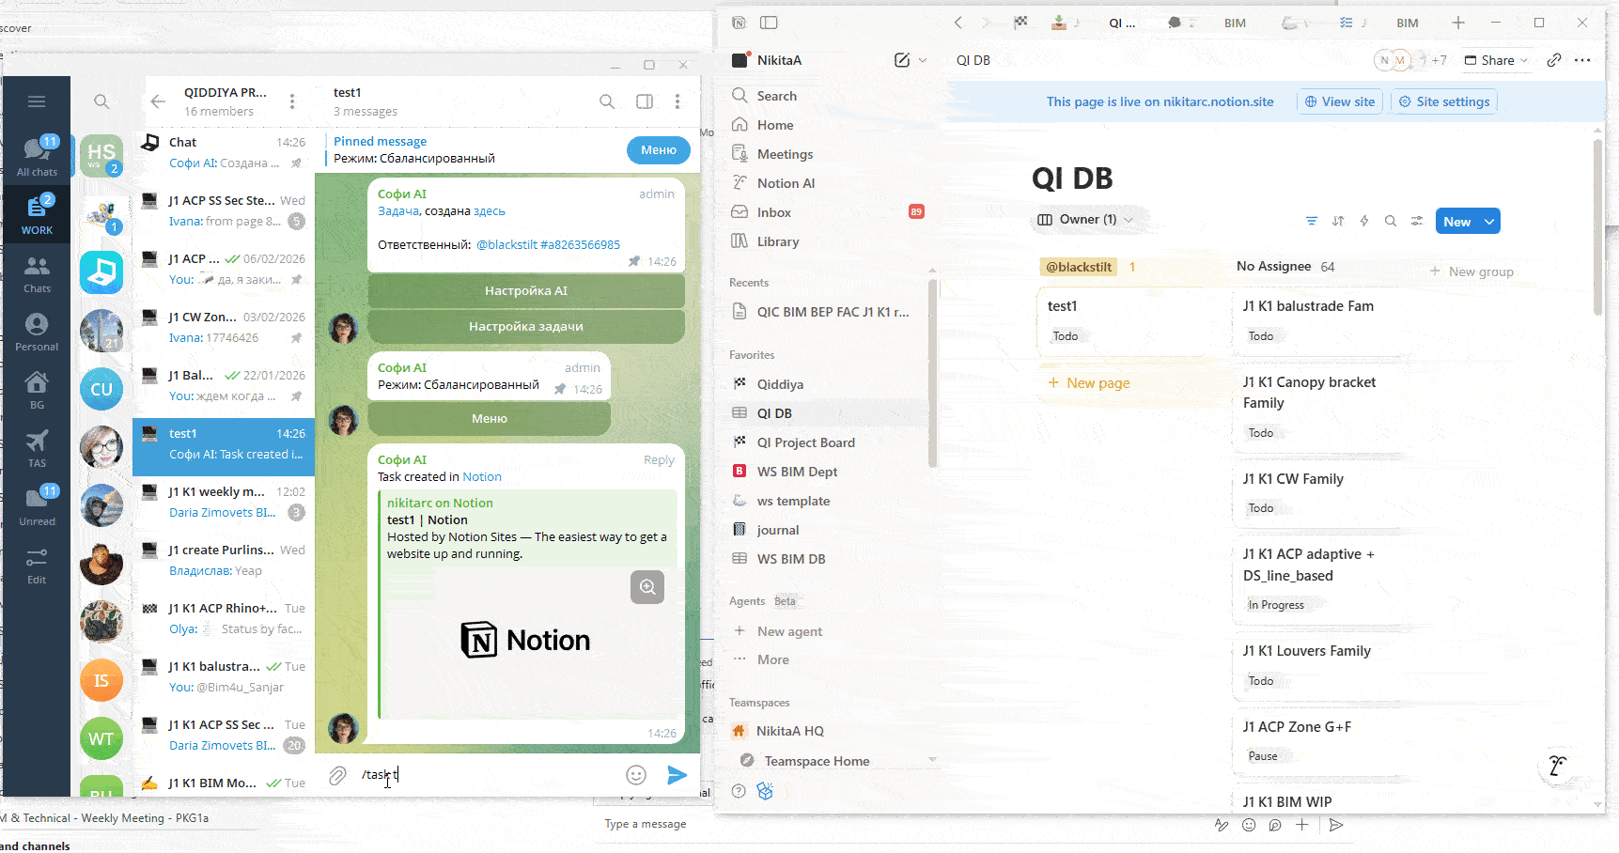
AI agents are helping with routine tasks tracking and updates
Integrations into team’s chat connects chat with tasktracker

